Slide 1
- BIM2TWIN -
Optimal Construction Management & Production Control

Slide 2
Introduction
BIM2TWIN aims to build a Digital Building Twin (DBT) platform for construction management that implements lean principles to reduce operational waste of all kinds, shortening schedules, reducing costs, enhancing quality and safety and reducing carbon footprint.
The platform will provide full situational awareness and an extensible set of construction management applications.

Slide 3
BIM2TWIN’s main challenges
Developing automated monitoring techniques for all stages of construction
Managing multiple streams of monitored data from site and the supply chain
Representing the current status of products and processes through a Project Status Model
Developing predictive analytics for construction progress using simulations
Building a decision support dashboard for forward planning and real-time control

Slide 4
BIM2TWIN construction management platform’s key features
Analysis of data in the context of DBTs based on a robust system architecture
Processing real-time data streams to establish a Project Status Model (PSM)
Exposure of the PSM to a suite of construction management applications
Monitoring of schedule, quantities & budget, quality, safety, and environmental impact
PSM representation semantically linked to the Building Information Model (BIM)

Slide 5
BIM2TWIN’s main objectives
Integrate in a single DBT platform different construction management tools (PSM+BIM+AI)
Test the platform, integrating monitoring technologies with management applications
Develop exploitation pathways and business models for the DBT platform
Demonstrate platform operation and measurable impacts in real pilots

Slide 6
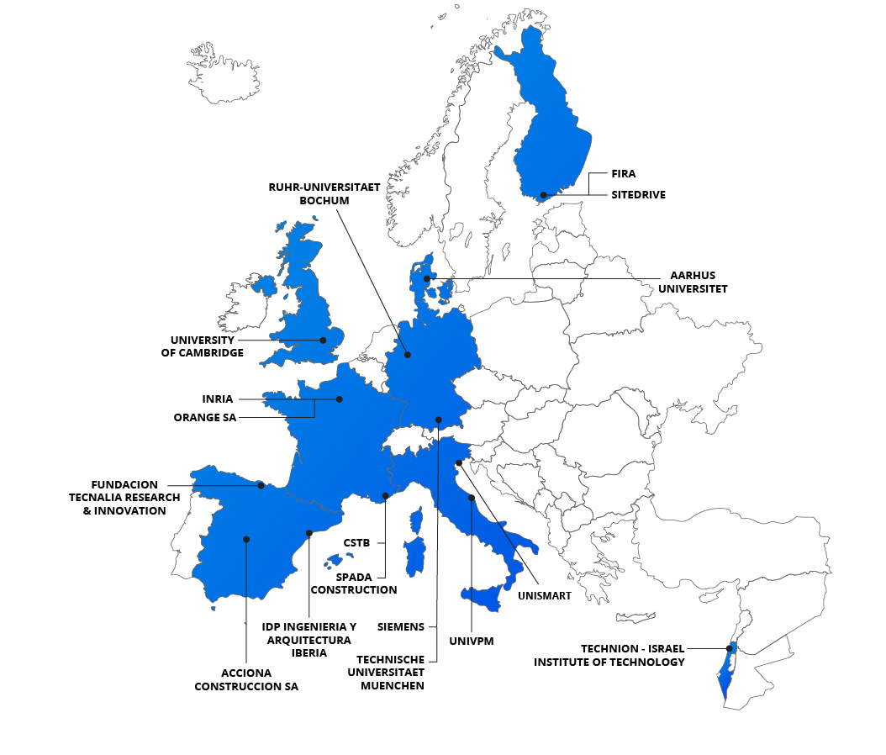
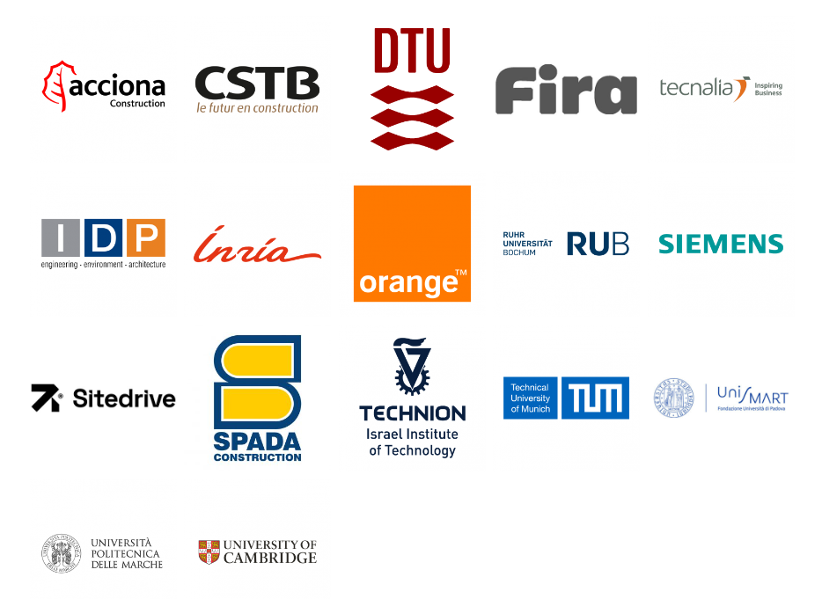
Partners

Slide 7
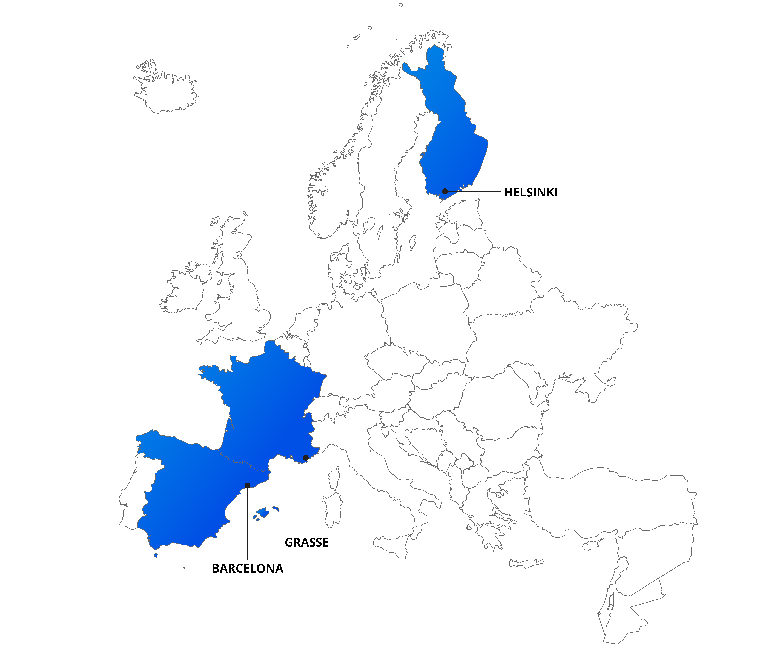
Demo Cases
Location of the site
Partner
Grasse
Barcelona
Helsinki
Spada
Acciona
Fira

Slide 8
Contact

